Slide 1
ARDS and Tables

Slide 2
ADaM -> Display
Pros
Cons
Great for simplicity
One program per display
Any time a change is to be made, program must be rerun
QC on rounded values
QCing plots?

Slide 3
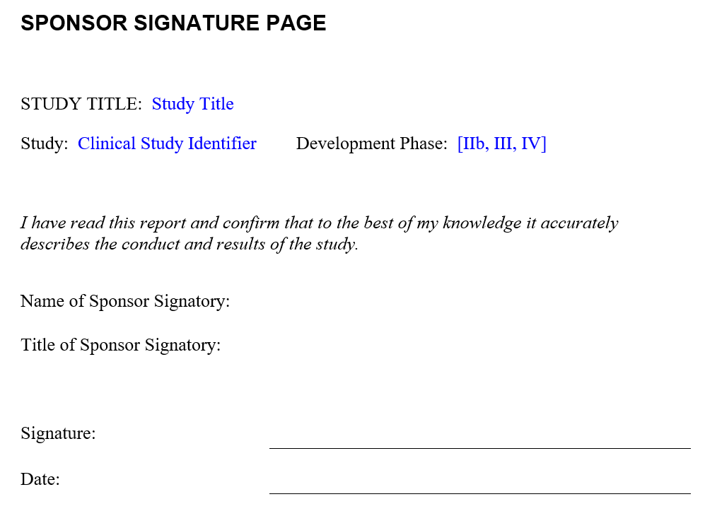
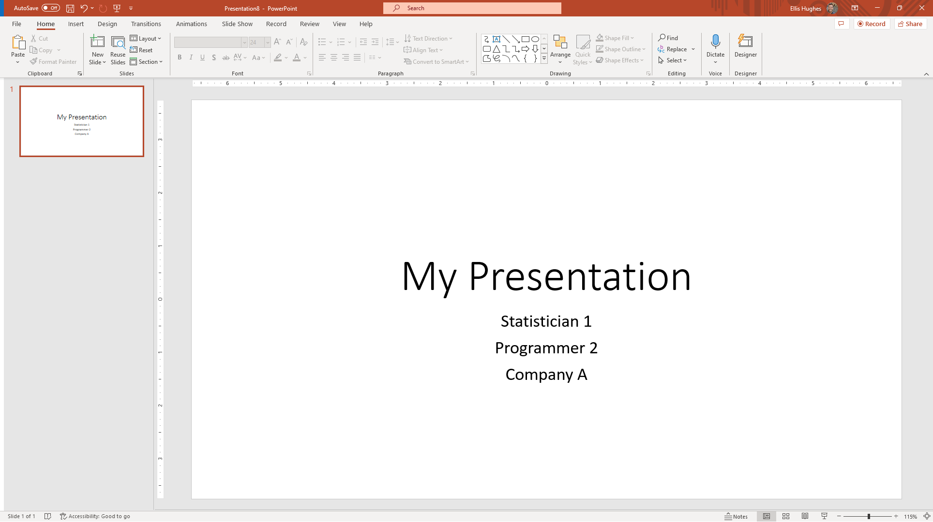
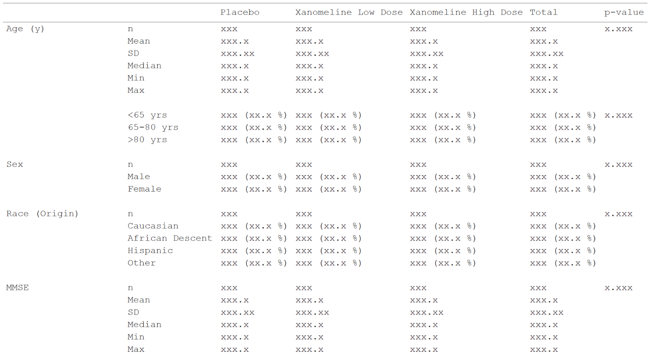

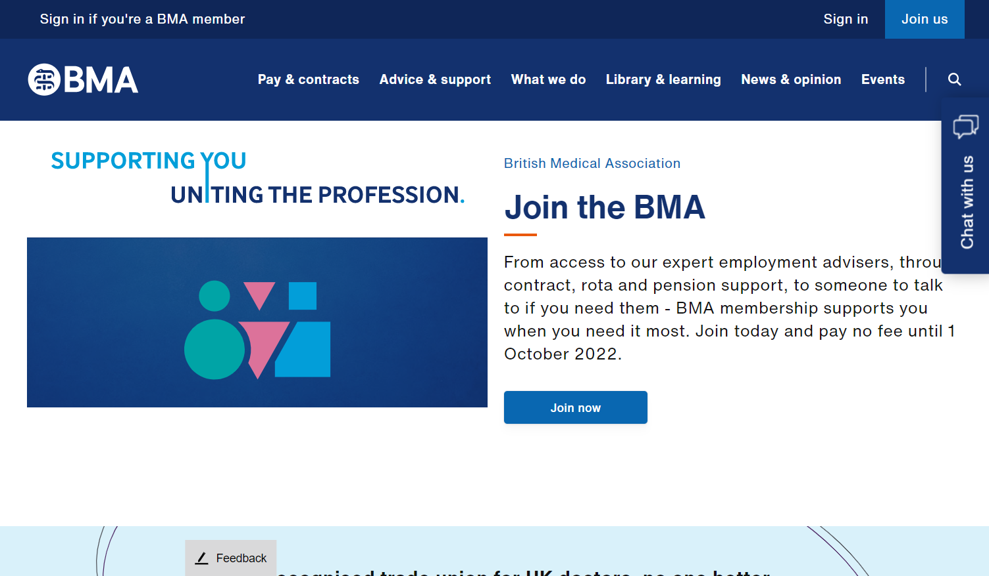

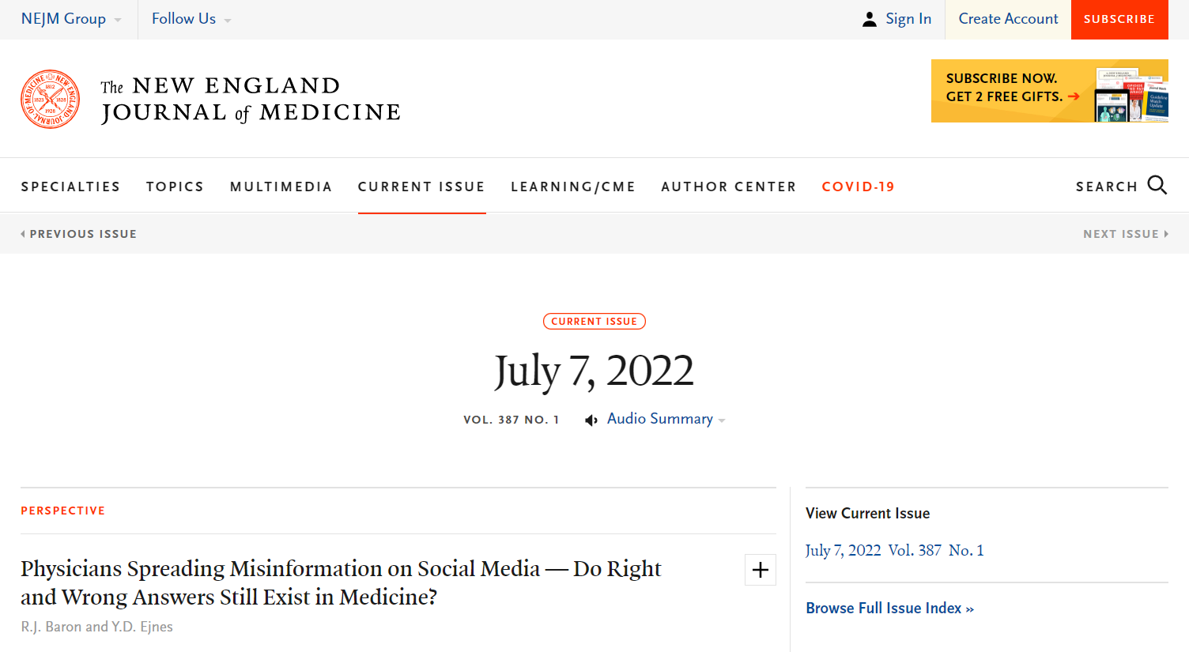
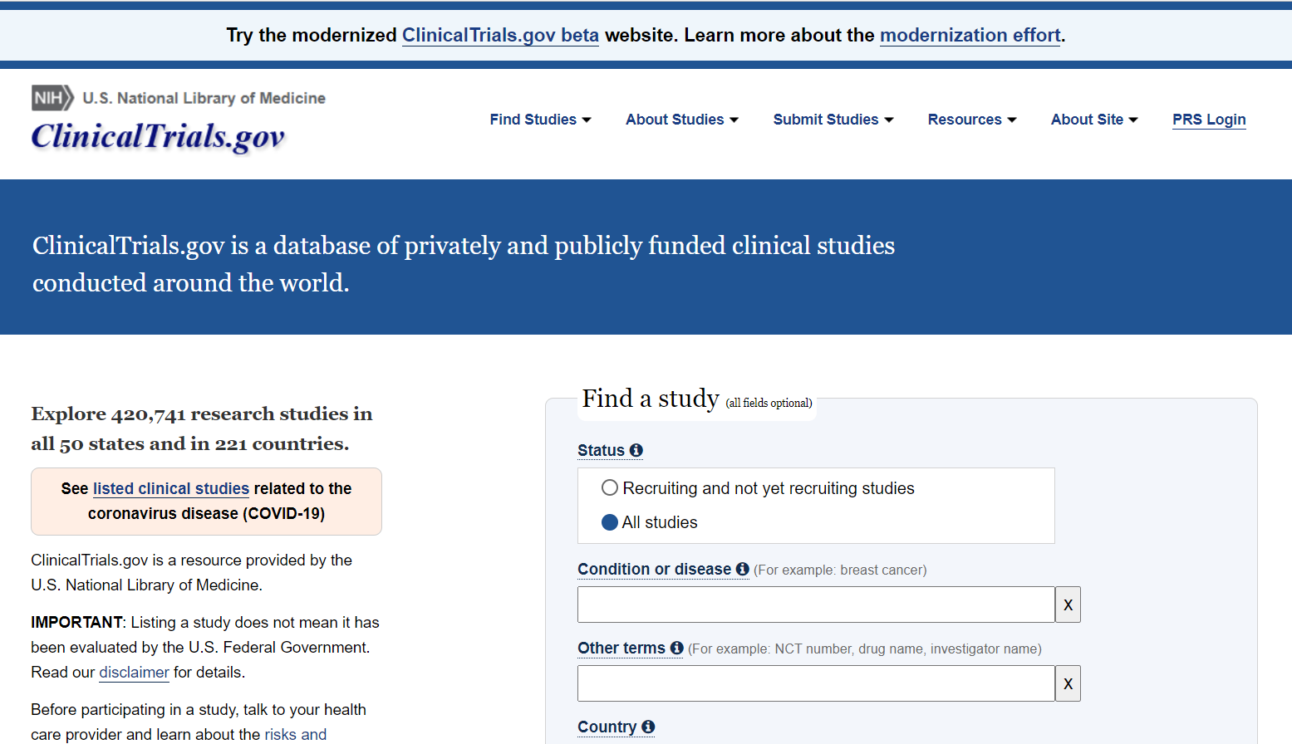
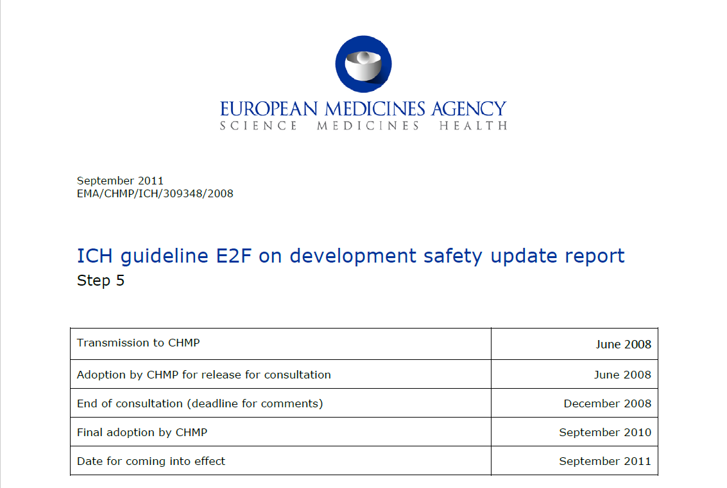
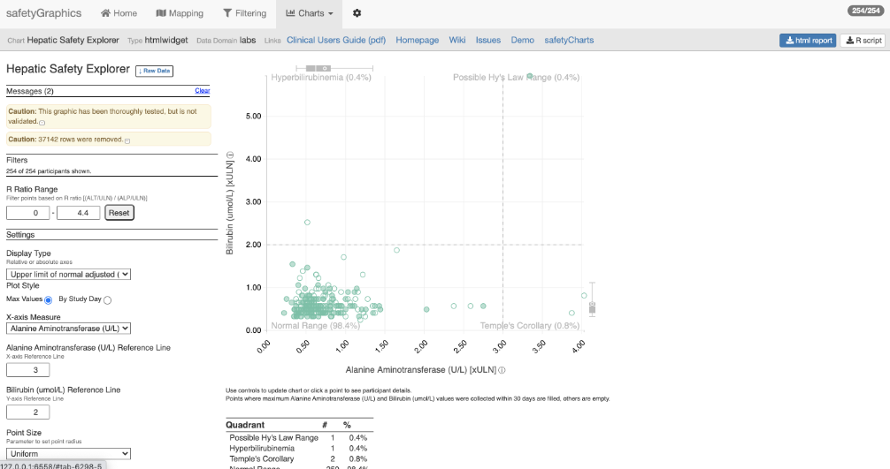
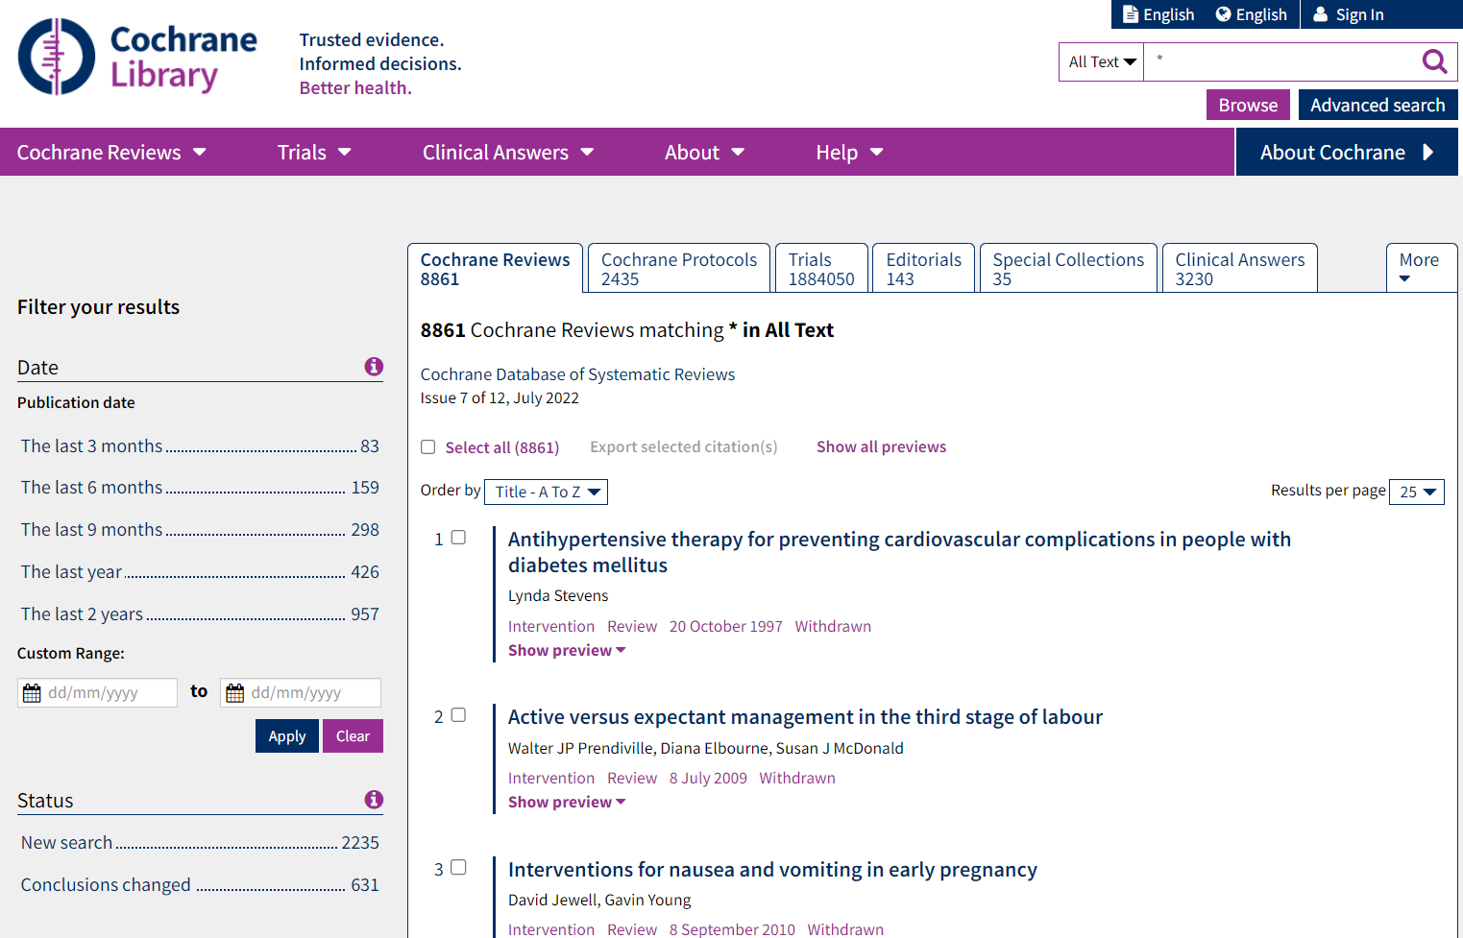
Analysis Results Data
The Possibilities
In-text CSR
Presentations
Submissions
Publications
Data Analysis
ADaM
Analysis Results Data
clinicaltrials.gov
Integrated safety reporting
Dynamic apps
Meta-analyses

Slide 4
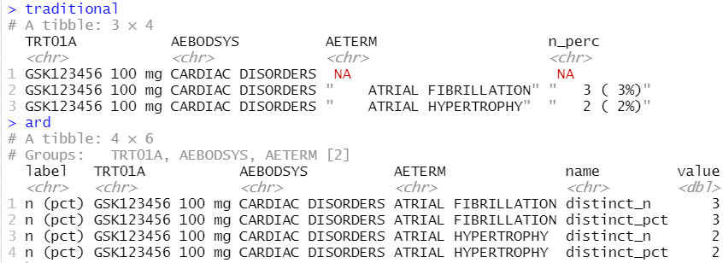
Analysis Results Data
Key features
Unformatted values
1 value per row
Distinct columns for each grouping variable
Include everything you want to display (particularly labels)
Interested in reading more, see:
Why we should respect analysis results as data
Why we should respect analysis results as data
Joana M Barros, Lukas A Widmer, Mark Baillie, Simon Wandel, (Analytics, Novartis Pharma AG, Basel, Switzerland)
https://doi.org/10.48550/arXiv.2204.09959
13 September 2023
4

Slide 5
Creating ARDs
ARD’s are naturally ‘Tidy’
A single row per record
Aligns with tidyverse approaches
Simplest approach is to use tidyverse to generate ARDs
Highly supported ecosystem
Lots of users
Documentation on development strategy, trusted authors, etc

Slide 6
Great, we have ARD’s, but you said we’d have tables

Slide 7



Analysis Results Data
The Possibilities
In-text CSR
Presentations
Submissions
Publications
Data Analysis
ADaM
Analysis Results Data
clinicaltrials.gov
Integrated safety reporting
Dynamic apps
Meta-analyses

Slide 8
{tfrmt}
General Purpose:
Building tables from ARDs based on metadata
Lifecycle:
Alpha release is out. Will likely go to CRAN by the end of the year once additional functionality is added
Common Functions:
tfrmt()
Setup a table
body_plan()
Defines the body of the table
frmt_structure()
Defines which rows to apply formatting to
frmt_combine()/frmt_when()/frmt()
Defines the formatting
col_plan()
Sets column appearance
row_grp_plan()
Defines the style for each group
print_mock_gt()
Prints to gt without data to produce a mock
print_to_gt()
Prints to gt with data to make final table
https://gsk-biostatistics.github.io/tfrmt/

Slide 9
Tables parts
 |  | Placebo (N = XX) | Treatment (N = XX) | Total (N = XX)
Age (y) | n | XX | XX | XX
 | Mean (sd) | XX.X(XX.XX) | XX.X(XX.XX) | XX.X(XX.XX)
 | Median | XX.X | XX.X | XX.X
 | Min, Max | XX,XX | XX,XX | XX,XX
 | <65 yrs | XX (XX.X%) | XX (XX.X%) | XX (XX.X%)
 | 65-80 yrs | XX (XX.X%) | XX (XX.X%) | XX (XX.X%)
 | >80 yrs | XX (XX.X%) | XX (XX.X%) | XX (XX.X%)
Sex | n | XX | XX | XX
 | Male | XX (XX.X%) | XX (XX.X%) | XX (XX.X%)
 | Female | XX (XX.X%) | XX (XX.X%) | XX (XX.X%)
Columns
Row groups
Labels and groups
Table body
Notes:
How can we break a table down into component parts

Slide 10
Tables parts
 |  | Placebo (N = XX) | Treatment (N = XX) | Total (N = XX)
Age (y) | n | XX | XX | XX
 | Mean (sd) | XX.X(XX.XX) | XX.X(XX.XX) | XX.X(XX.XX)
 | Median | XX.X | XX.X | XX.X
 | Min, Max | XX,XX | XX,XX | XX,XX
 | <65 yrs | XX (XX.X%) | XX (XX.X%) | XX (XX.X%)
 | 65-80 yrs | XX (XX.X%) | XX (XX.X%) | XX (XX.X%)
 | >80 yrs | XX (XX.X%) | XX (XX.X%) | XX (XX.X%)
Sex | n | XX | XX | XX
 | Male | XX (XX.X%) | XX (XX.X%) | XX (XX.X%)
 | Female | XX (XX.X%) | XX (XX.X%) | XX (XX.X%)
tfrmt(…,
group = “var1”,
label = “var2”,
body_plan = body_plan(),
col_plan = col_plan(),
row_grp_plan = row_grp_plan()
)
Notes:
Tfrmt works by letting you set the styling of each component part

Slide 11
tfrmt with Analysis Results Data
Group | Label | Column | Param | Value
Age (y) | n | Placebo | n | 15.00
Age (y) | n | Treatment | n | 13.00
Age (y) | n | Total | n | 28.00
Sex | n | Placebo | n | 14.00
Sex | n | Treatment | n | 13.00
Sex | n | Total | n | 27.00
Age (y) | Mean (sd) | Placebo | mean | 73.56
Age (y) | Mean (sd) | Treatment | mean | 74.231
Age (y) | Mean (sd) | Total | mean | 71.84
Age (y) | Mean (sd) | Placebo | SD | 9.347
Age (y) | Mean (sd) | Treatment | SD | 7.234
Age (y) | Mean (sd) | Total | SD | 8.293
tfrmt(
group = Group,
label = Label,
column = Column,
values = Value,
param = Param,
…
)
 |  | Placebo | Treatment | Total
Age (y) | n | 15 | 13 | 28
 | Mean (sd) | 73.6(9.35) | 74.2(7.23) | 71.8(8.29)
Sex | n | 14 | 13 | 27
 | Male | 8 (57.1%) | 7 (53.8%) | 15 (55.6%)
 | Female | 6 (48.2%) | 6 (46.1%) | 12 (44.4%)
Notes:
Parameters allow you to combine elements and create conditional formatting for values with the same label

Slide 12
Value formatting
body_plan(
frmt_structure(
group_val = ".default",
label_val = ".default",
frmt_combine("{n} ({pct}%)",
n = frmt("X"),
pct = frmt("xx.x")
)
),
frmt_structure(
group_val = ".default",
label_val = "n",
frmt("XX")),
frmt_structure(
group_val = "Age (y)",
label_val = "Mean (sd)",
frmt_combine("{mean}({SD})",
mean = frmt("XX.X"),
SD = frmt("x.xx")
)
)
)
Group | Label | Column | Param | Value
Age (y) | n | Placebo | n | 15.00
Age (y) | n | Treatment | n | 13.00
Age (y) | n | Total | n | 28.00
Sex | n | Placebo | n | 14.00
Sex | n | Treatment | n | 13.00
Sex | n | Total | n | 27.00
Age (y) | Mean (sd) | Placebo | mean | 73.56
Age (y) | Mean (sd) | Treatment | mean | 74.231
Age (y) | Mean (sd) | Total | mean | 71.84
Age (y) | Mean (sd) | Placebo | SD | 9.347
Age (y) | Mean (sd) | Treatment | SD | 7.234
Age (y) | Mean (sd) | Total | SD | 8.293
 |  | Placebo | Treatment | Total
Age (y) | n | 15 | 13 | 28
 | Mean (sd) | 73.6(9.35) | 74.2(7.23) | 71.8(8.29)
Sex | n | 14 | 13 | 27
 | Male | 8 (57.1%) | 7 (53.8%) | 15 (55.6%)
 | Female | 6 (48.2%) | 6 (46.1%) | 12 (44.4%)

Slide 13
{tfrmt}
General Purpose:
Building tables from ARDs based on metadata
Lifecycle:
Available on CRAN, functionality being slowly added based on need.
Common Functions:
tfrmt()
Setup a table
body_plan()
Defines the body of the table
frmt_structure()
Defines which rows to apply formatting to
frmt_combine()/frmt_when()/frmt()
Defines the formatting
col_plan()
Sets column appearance
row_grp_plan()
Defines the style for each group
print_mock_gt()
Prints to gt without data to produce a mock
print_to_gt()
Prints to gt with data to make final table
https://gsk-biostatistics.github.io/tfrmt/

Slide 14
{tfrmtbuilder}
General Purpose:
Taking tfrmt json files
Lifecycle:
Early release available on github. Will likely go to CRAN soon.
Common Function:
tfrmtbuilder()
Runs internal shiny app to allow you to edit the tfrmt json
https://gsk-biostatistics.github.io/tfrmtbuilder/

Slide 15

Demo time
Notes:
Walk through a metadata example
Also talk about layerings with templates

Slide 16
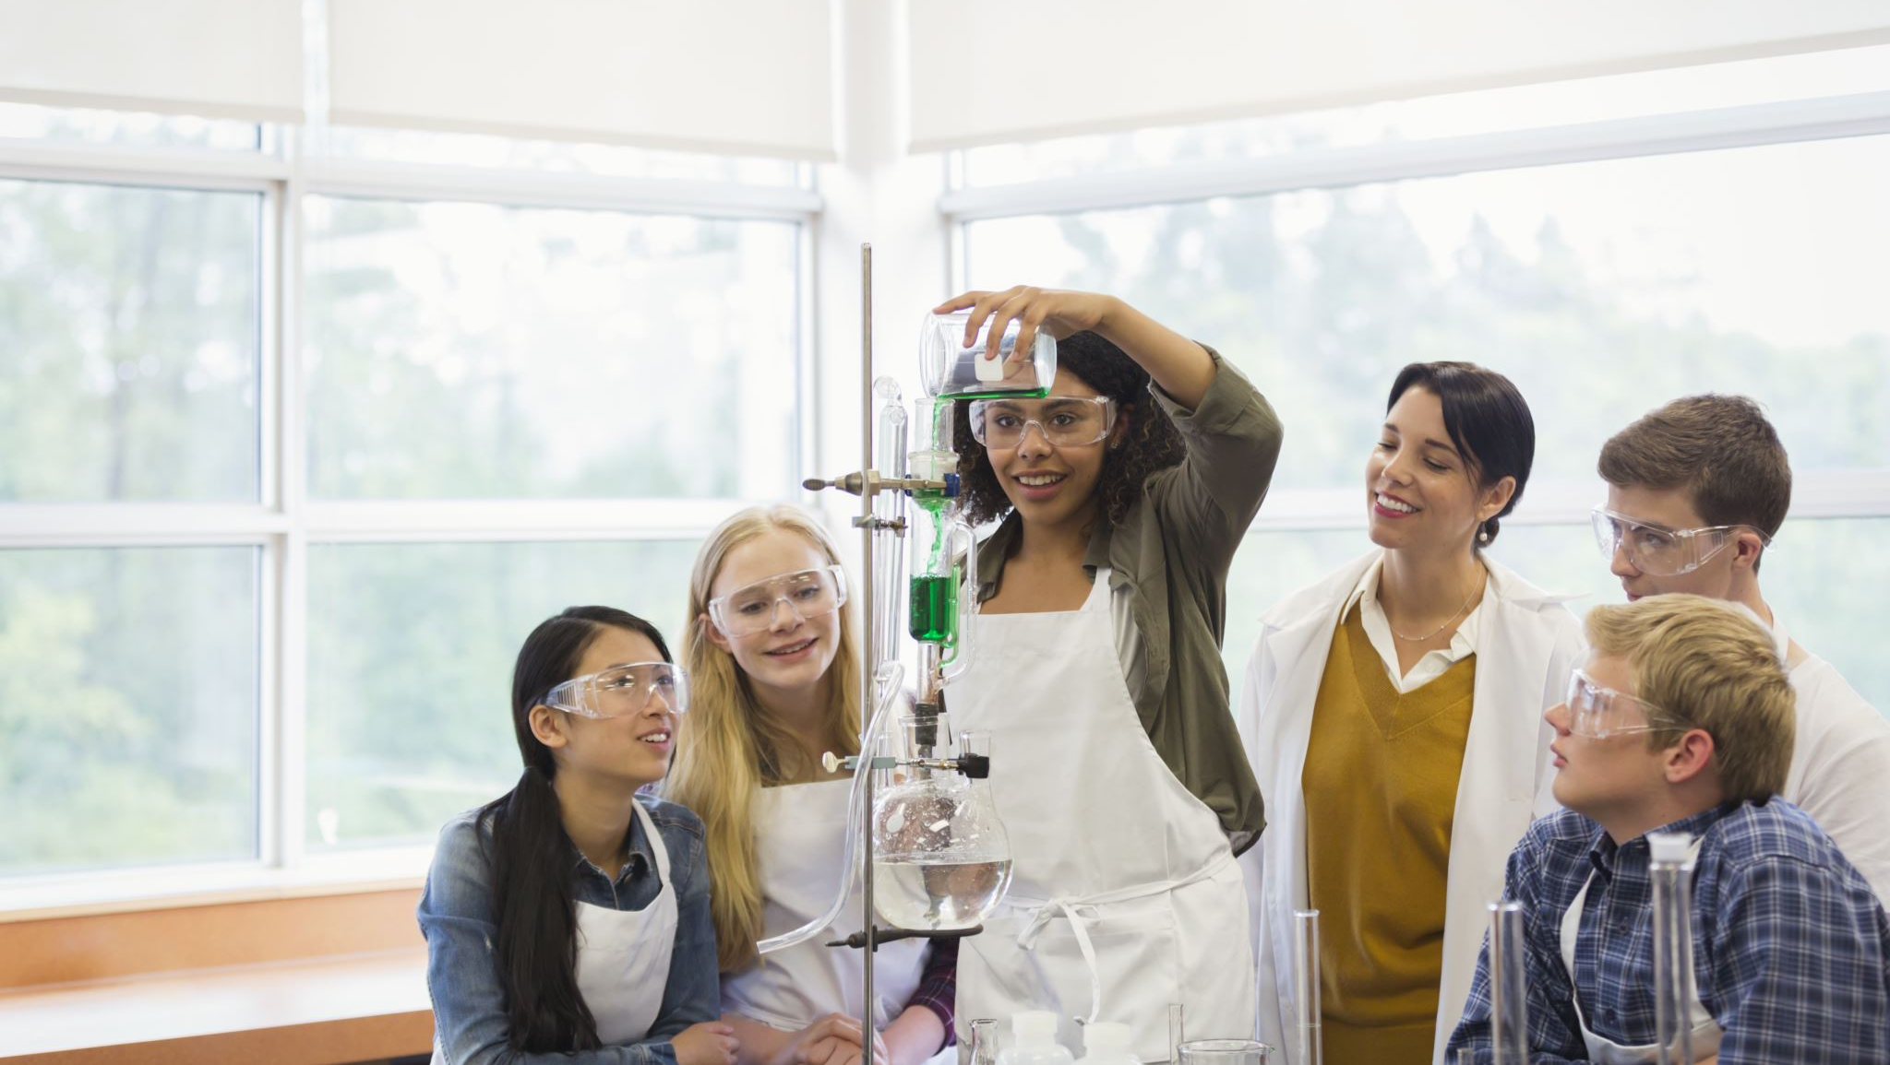
Exercise time
02-ARDs_and_Displays/02-demog_ard_exercise.R
02-ARDs_and_Displays/03-demog_table_exercise.R
Notes:
Go through each set in the process flow. Also open specs

